Slide 1
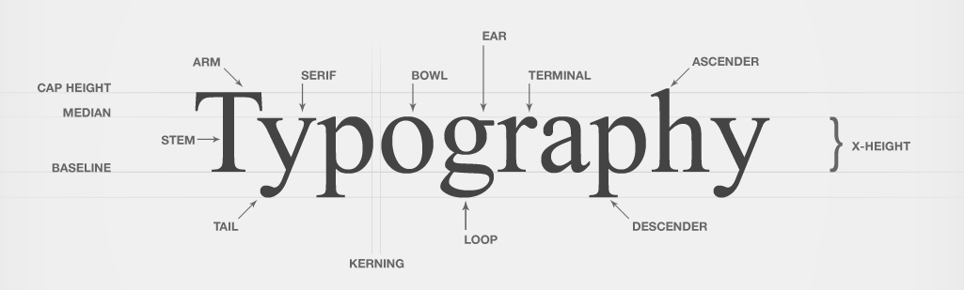
Introduction to

Slide 2
Learning Goals: Demonstrate an understanding of the history and development of media art forms Apply the critical analysis process to evaluate the effectiveness of media art works | Success Criteria: Participate in class discussion and group analysis, offering thoughts and personal insights Locate and correctly identity an example for each typeface category and analyze its effectiveness, taking into account the intended message Analysis is specific to example, provides evidence, and responds to each of the questions in complete sentences

Slide 3
Typography:
The art and technique of arranging type to make written language legible, readable, and appealing when displayed.
The arrangement of type involves selecting typefaces, point sizes, line lengths, line-spacing, and letter-spacing, and adjusting the space between pairs of letters.

Slide 4
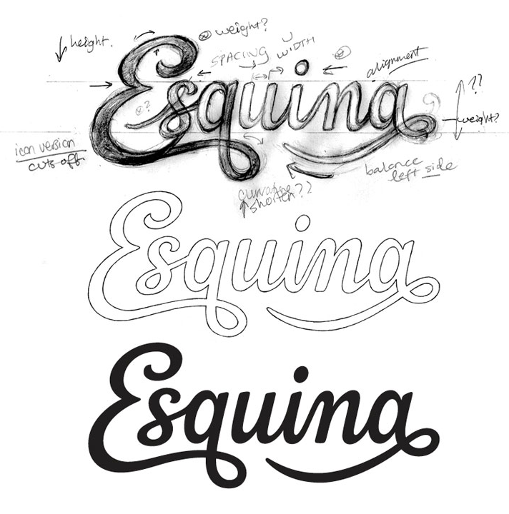
Typographers generally do not design fonts – this is the job of a type designer. Rather, typographers decide how a particular font will be arranged to achieve a desired effect.

Slide 5
History of Typography (Briefly)
First known written symbols were developed in ancient Mesopotamia, Egypt, and China, beginning around 3,500 BC.
Pictographs: pictures that resemble what they signify
Ideograms: symbols that represent ideas (abstract)

Slide 6
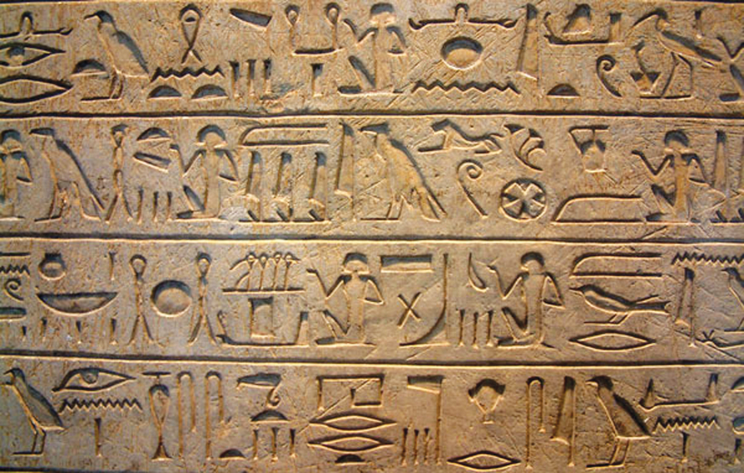
The hieroglyphics of ancient societies (such as Egyptian and Native American) used both!

Slide 7
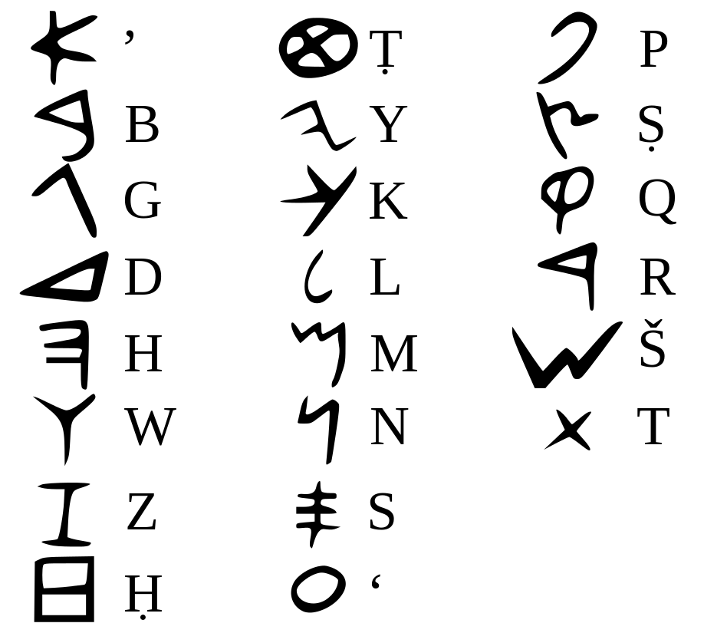
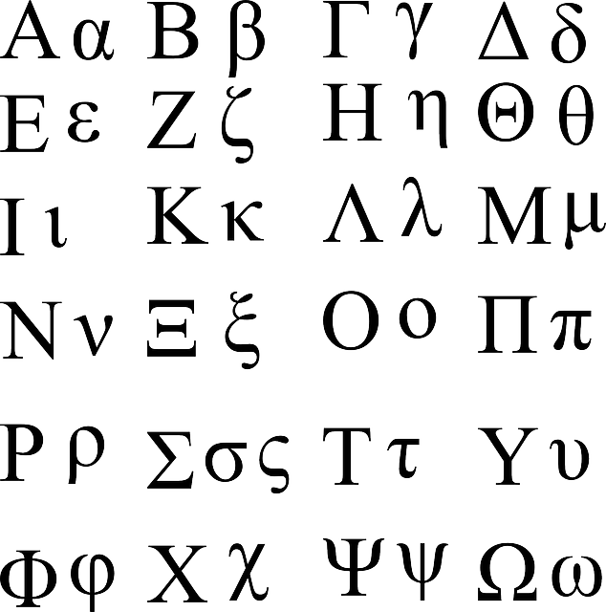
Phoenician alphabet, c. 1200 BC
(first use of letters only)
Greek alphabet, c. 800 BC
(first use of vowels)

Slide 8
Later, around the 2nd century BC, ancient Romans adapted the Greek alphabet by using 23 letters, and developing a typeface that was the first to include thick and thin strokes.

Slide 9
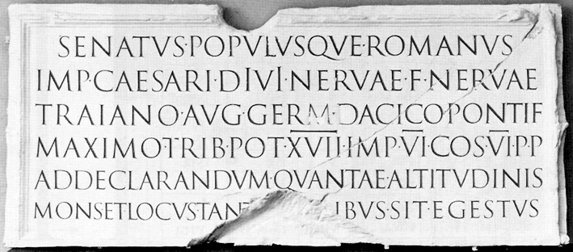
Inscription from Trajan’s column, 113 AD

Slide 10
Around 732 AD, Roman Emperor Charlemagne ordered the development of the lowercase alphabet, which was called the Carolingian miniscule

Slide 11
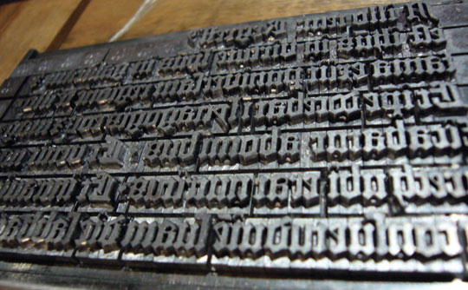
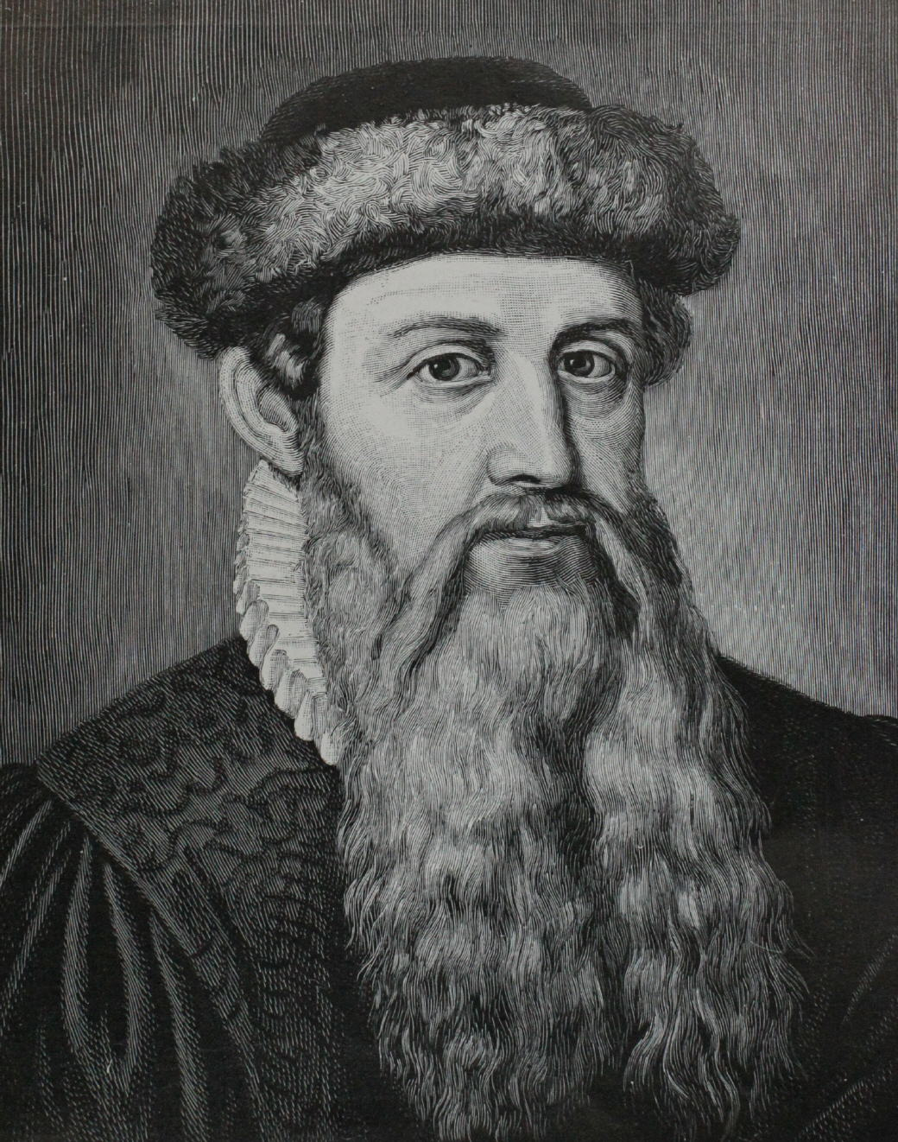
Movable type, which gives us the ability to reproduce identical letters and print them onto paper, was introduced to the Western world with the invention of the Gutenberg press in 1450 by German blacksmith Johannes Gutenberg.

Slide 12
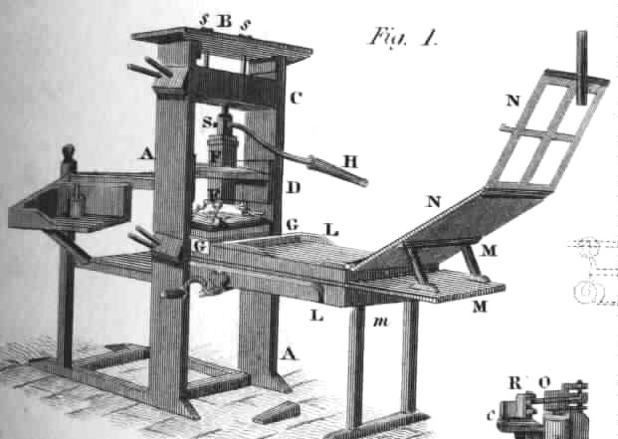

Slide 13
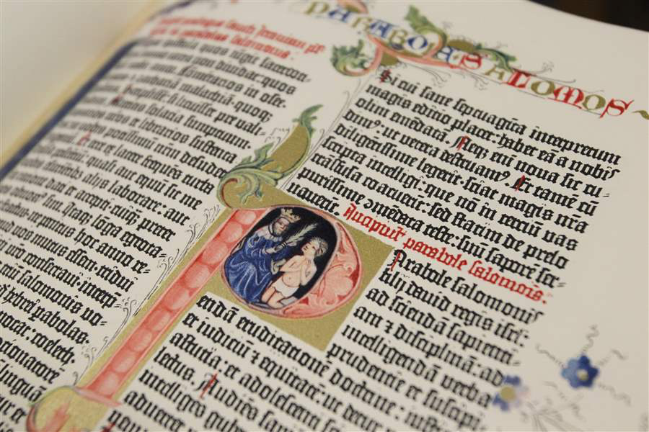
The Gutenberg Bible was the first mass-produced book.

Slide 14
As written systems of communication and typesetting techniques developed…
so too did typefaces …

Slide 15
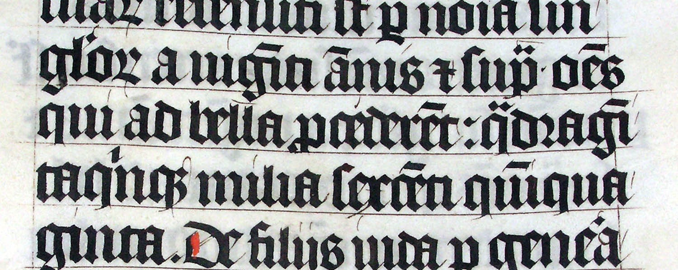
1. Blackletter (aka Gothic script)
First style of mechanically-printed alphabet
Modeled after the hand-lettering style of scribes
Elaborate and ornamental

Slide 16
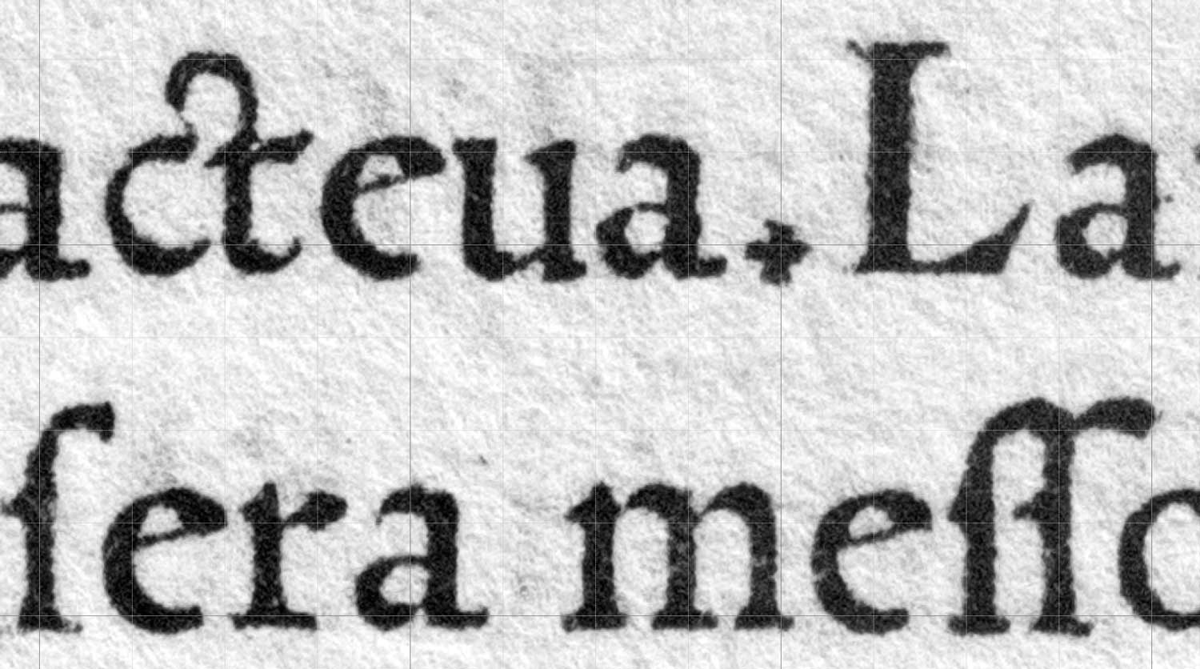
2. Roman (aka Antiqua)
Replaced blackletter as the dominant style
Modeled after ancient Roman styles
Simple, easier to read, used less paper

Slide 17
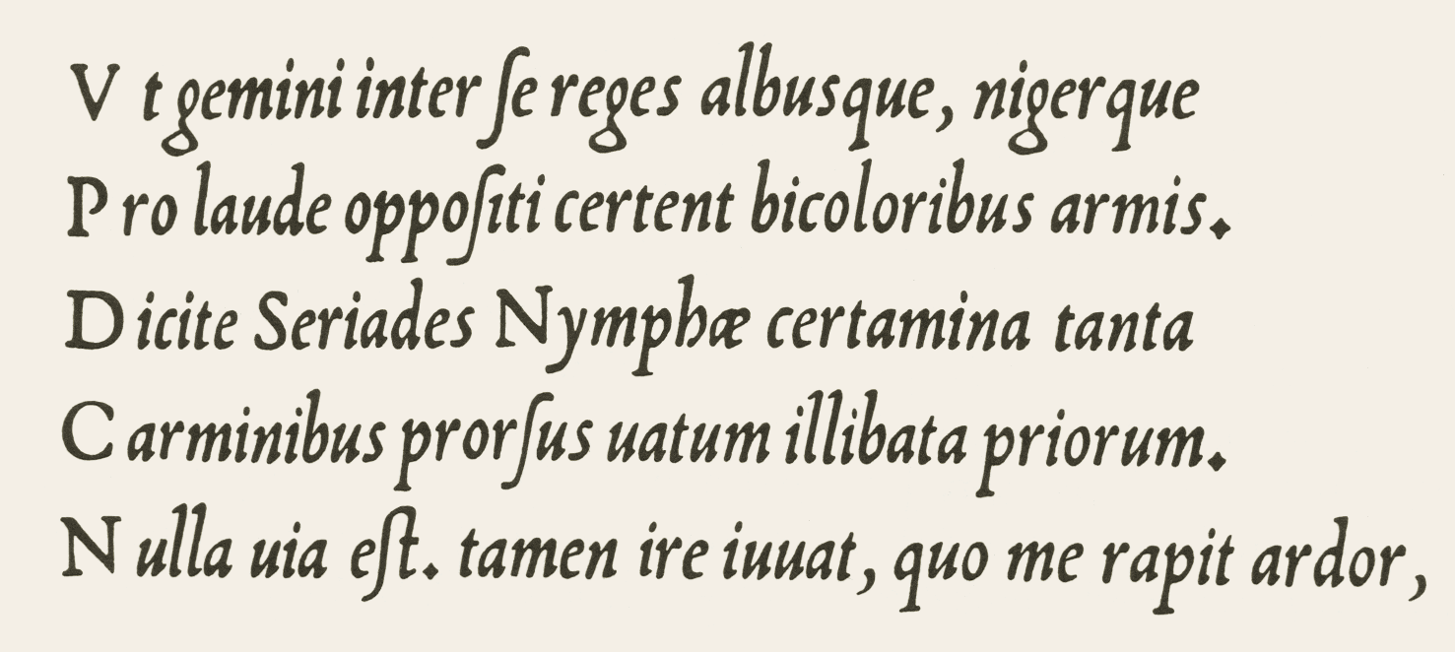
3. Italic
Modeled after cursive handwriting styles
First used in 1500, designed to save space
Angled, sloping, compact

Slide 18
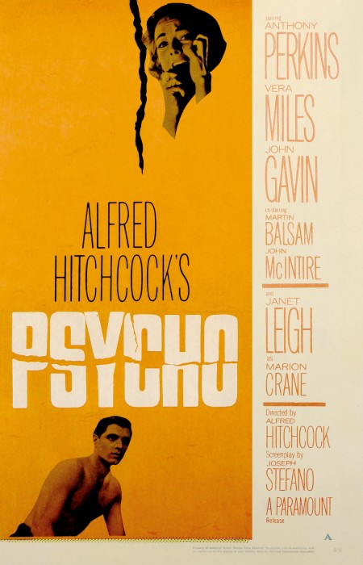
By the mid-20th century, developments in digital typesetting and computer software allowed for typography to rise to the creative and innovative craft that it is today…

Slide 19
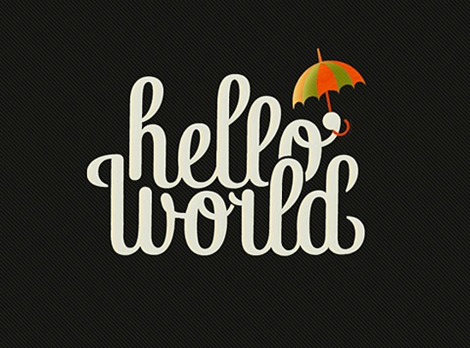
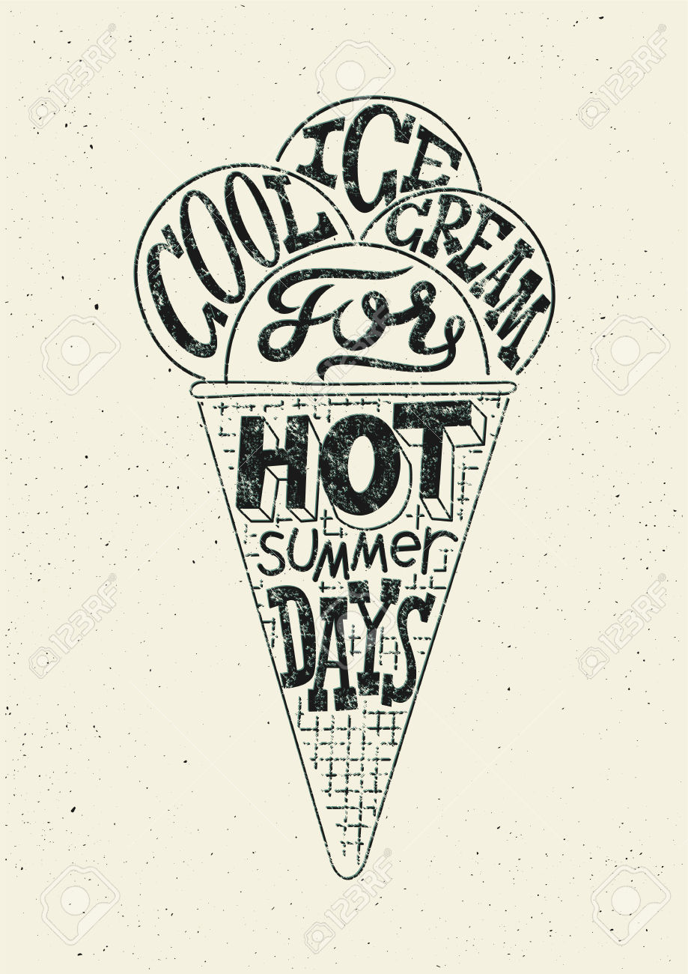
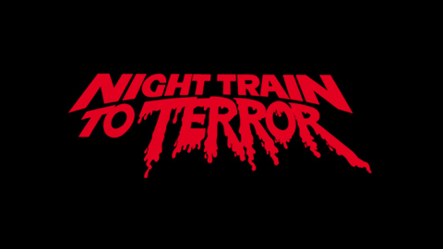

Slide 20
Digitized fonts are called vector fonts, because they are defined by shapes and line segments.
Like with a vector graphic, these fonts can be resized and manipulated with no loss of resolution.

Slide 21
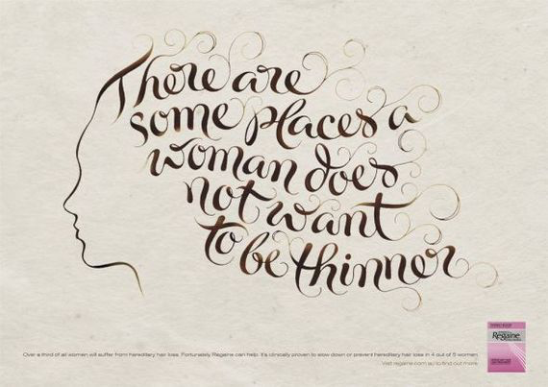

Slide 23
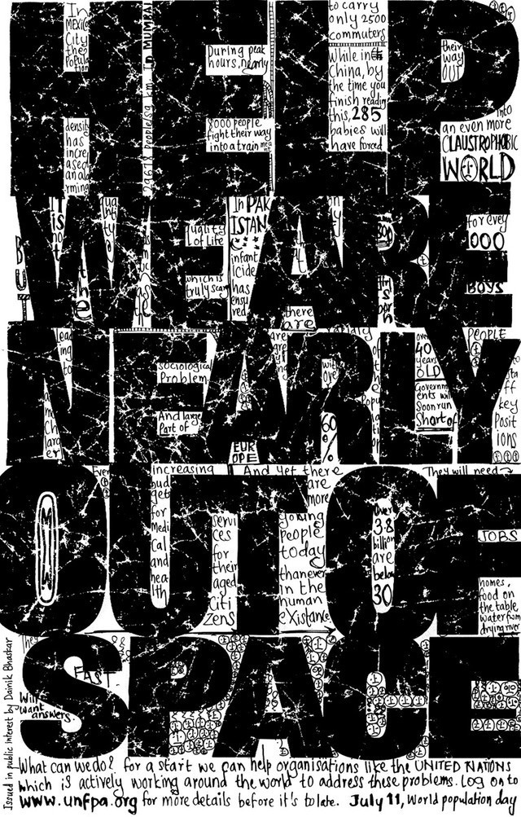

Slide 24
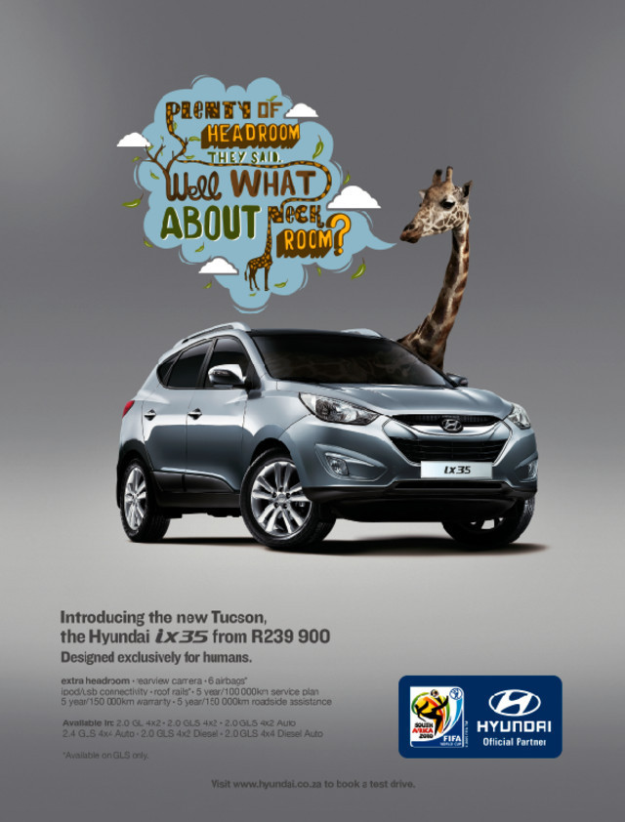

Slide 25
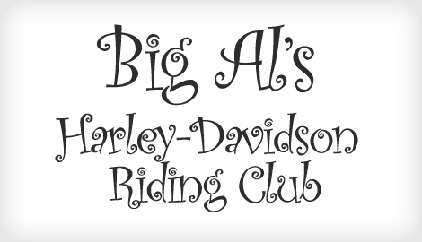

Slide 26
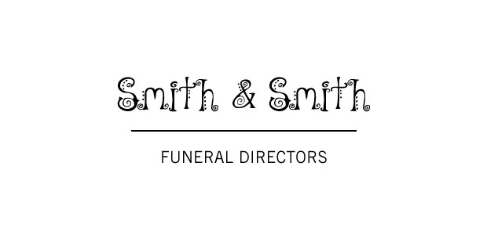

Slide 27
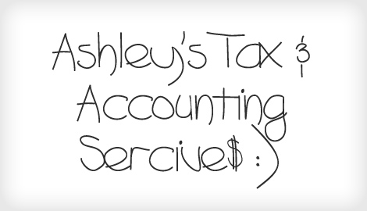

Slide 29
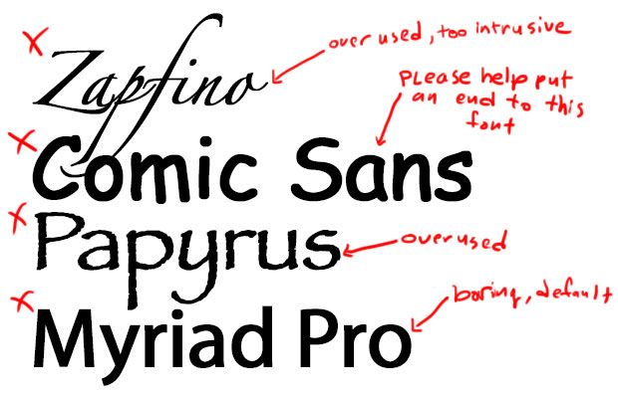

Slide 30
Font Categories
SERIF
SANS SERIF
SCRIPT
CROSSOVER

Slide 31
Serif Fonts: Fonts that have small features/feet at the end of strokes.
These are easy to read because the serif leads your eye from one letter to the next. They are typically used for body copy and give off a formal, conventional, traditional feeling.

Slide 32
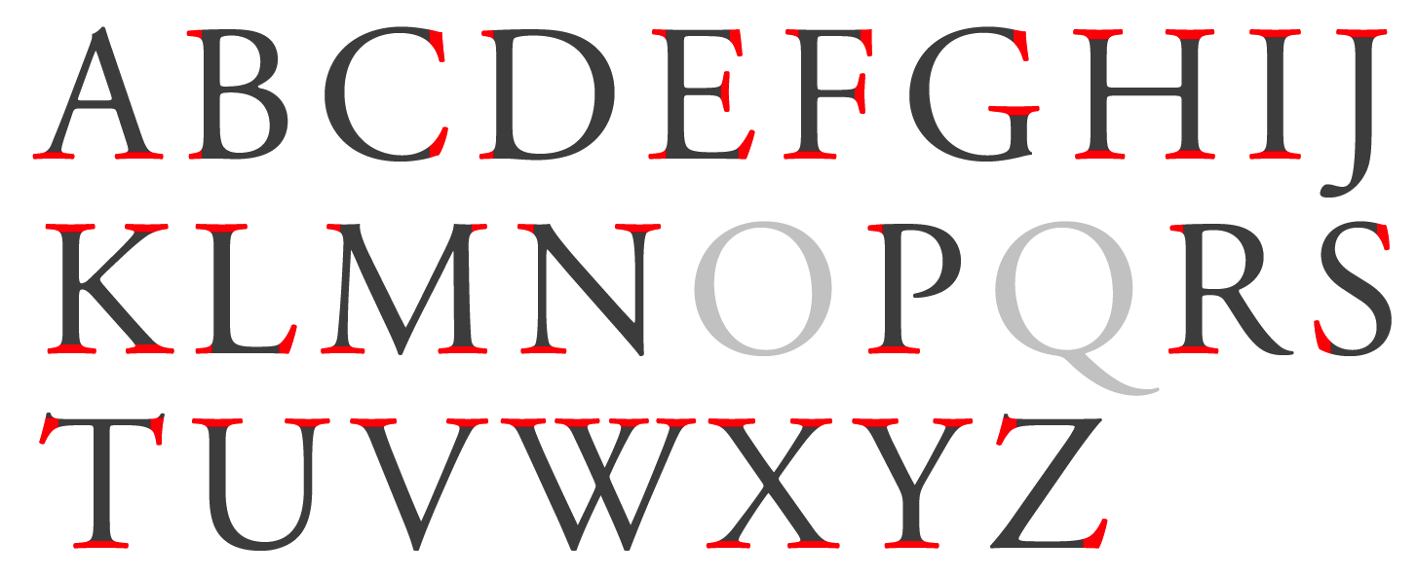
Serif Fonts

Slide 33
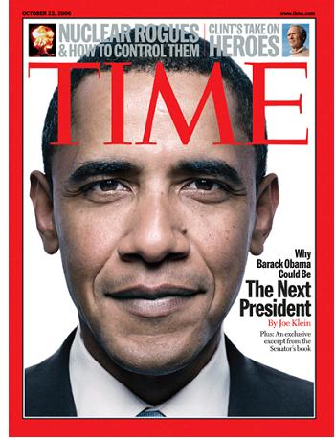

Slide 34
Sans Serif Fonts: Fonts that do not have serifs at the end of strokes.
These are often used when simplicity, minimalism, and a more modern look is desired.

Slide 35
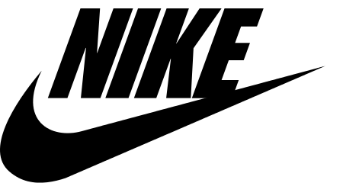
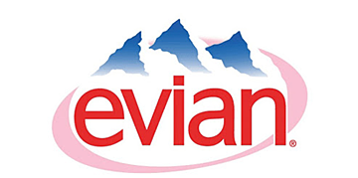
Sans Serif Fonts

Slide 36
Script Fonts: Fonts that have a more varied and fluid script, similar to handwriting or cursive.
These are often divided into “formal” types and looser, more casual scripts.

Slide 37
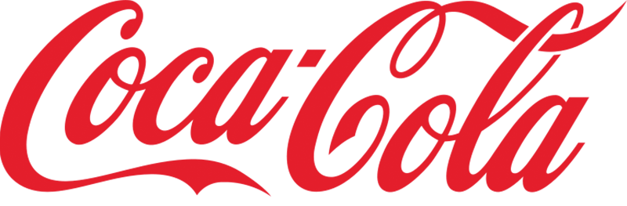
Script Fonts

Slide 38
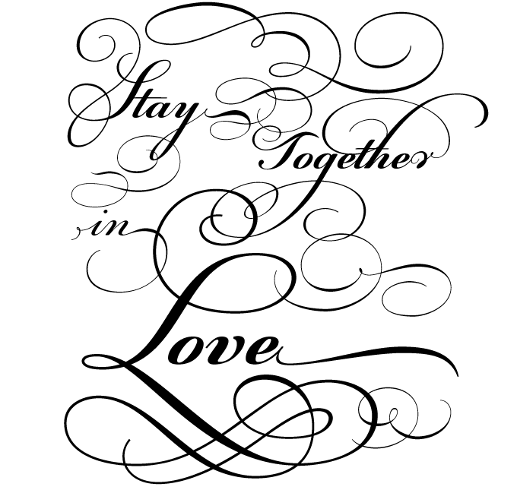

Slide 39
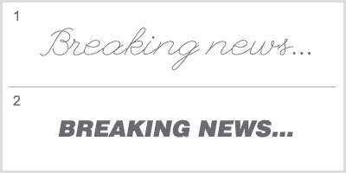

Slide 40
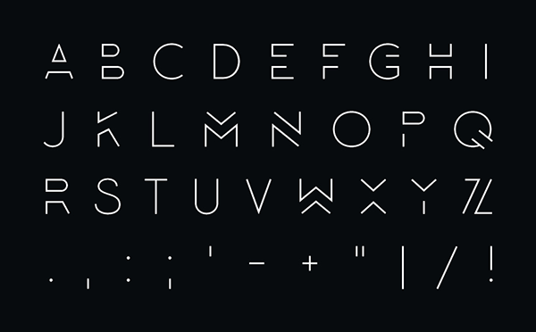
Crossover Fonts: Fonts that combine elements of more than one typeface category.
With new fonts being created daily, it is often difficult to categorize them.

Slide 41
When arranging typefaces, it is important to make your text legible and readable…

Slide 42
Legibility: Related to the speed at which each letter combination or word can be recognized (serif fonts are the most legible).
Readability: How easily the words are read on the page. This is connected to word placement, direction and arrangement.

Slide 43
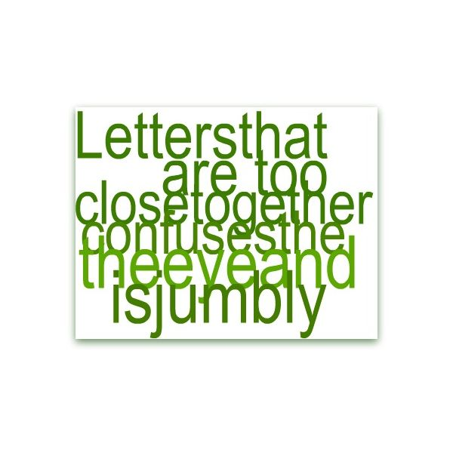

Slide 44
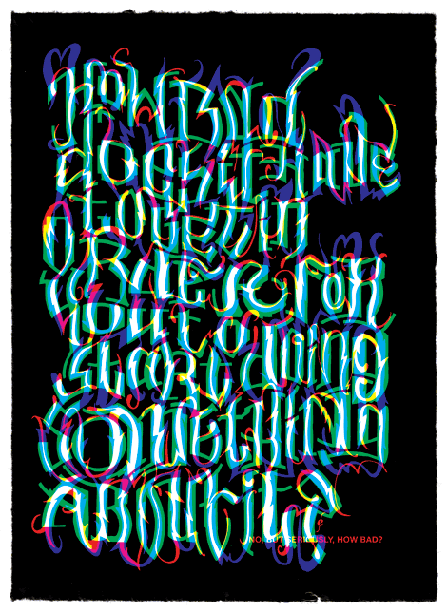

Slide 45
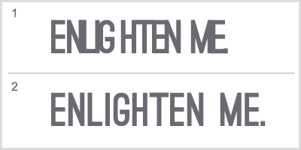

Slide 46
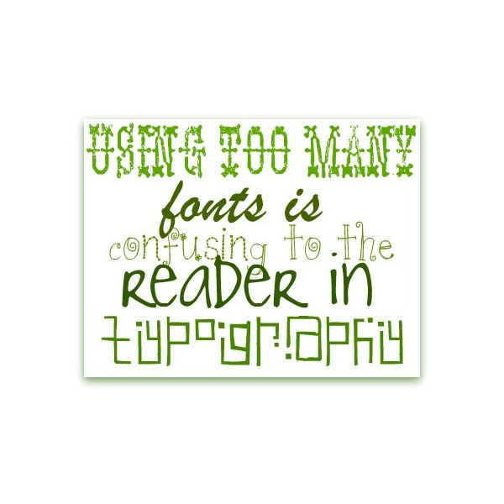

Slide 47
Typeface Analysis
Find an example online of each of the three typeface categories – Serif, Sans Serif, and Script – being used in a logo, poster, or advertisement.
Under each image, answer the following questions and post to your blog:
What is the typeface category?
What words describe the feeling the typeface creates (e.g. modern, formal, etc.)?
What is being advertised? Be specific.
Do you think that the style of the typeface BEST suits what is being advertised? Why or why not?

