Slide 1
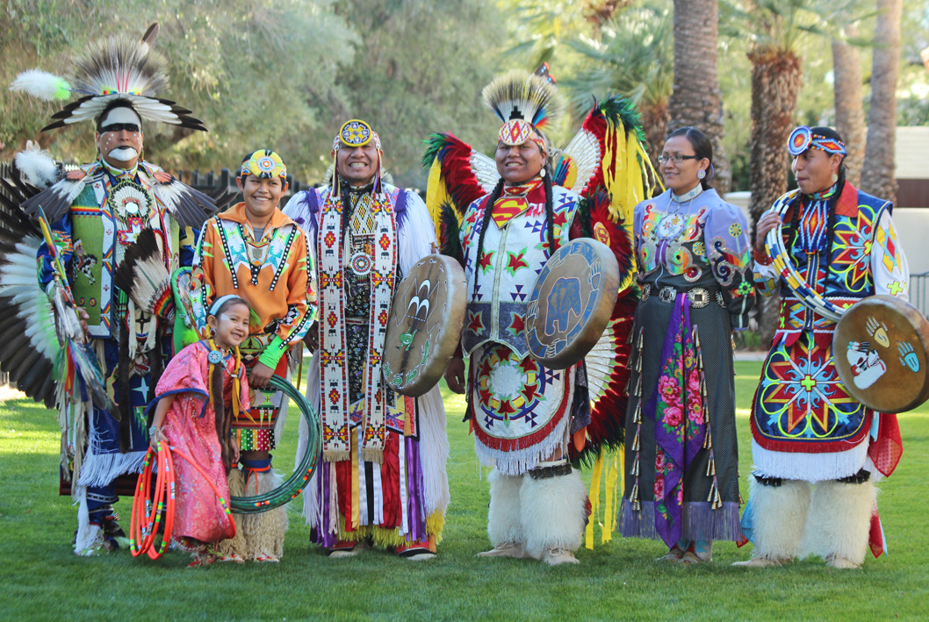
THE MAGNIFICIANT METIS
Culture project
Block G
Gavin Raymond

Slide 2
TABLE OF CONTENTS
3……………………………..INTRODUCTION
4……………………………..WEAPONS
5……………………………..FOODS
6……………………………..LANGUAGE
7……………………………..SPORTS
8……………………………..CLOTHING
9……………………………..LIVING
10……………………………TRANSPORTATION
11……………………………HISTORY
12……………………………TRADITIONS
13……………………………ART

Slide 3
INTRODUCTION
The social behaviour and norms found in human societies. Culture is considered a central concept in anthropology, encompassing a range of phenomena that are transmitted through social learning in human societies (Orgtology)

Slide 4
WEAPONS
The main weapons the metis used were lever action Winchester, double barrel shotguns, and muskets. They used buffalo bones to make knives, pipes, arrowheads, shovels, and even clubs. The metis used buffalo skin to make containers, shields , buckets, ropes, and even bags. The metis also used these nine pound field guns which were mainly used by infantry men. The field guns had a crazy range of 3’000 yards.
MY COMMENT
I find it crazy how heavy the field guns are, and not just that they shoot so far and another thing is that I find that so cool how they us buffalo bones and skin to make weapons.

Slide 5
FOODS
The main foods that the metis ate was antelope, moose, elk, mule, deer, prairie bush rabbits, chicken, duck, geese, and the main fish was salmon. When they caught buffalo they dried it and cut it into small pieces and the metis called it buffalo jerky. The metis also ate a lot of bannock.
MY COMMENT
In my opinion I find it gross that they ate geese and rabbits and stuff like that but I mean I understand that’s what they have to do so I would probably do the same if I was in the metis shoes.

Slide 6
LANGUAGE
The metis are primarily known for speaking michif the metis languages, including French michif, A dialect of Canadian French with some Algonquian linguistic features The language spoken mainly in southern and central Saskatchewan.
MY COMMENT
I find there language so cool cause its so unique and I tried reading some of those words but its hard.

Slide 7
SPORTS
During recess, the metis would play pickup games of soccer and baseball. Between 1950 and 1960, new schools with modern gyms were built and they played I door sports like volleyball, basketball and even badminton. The metis would also get together with friends and family to play games of skill or chance like billiards, chess, checkers, dominoes or various card games. MY COMMENT
I find it cool that they played chess back then it probably was a lot different but I'm sure it was still fun.

Slide 8
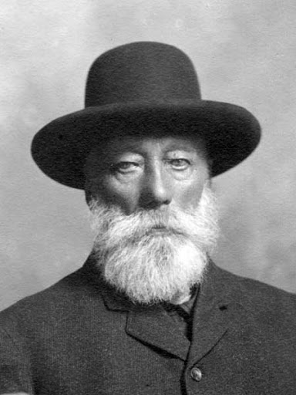
CLOTHING
Metis clothing was a blending of that worn by French-Canadien fur traders and first nation groups. The men wore deerskin pants, leggings, moccasins, and a long hooded coat called a capote, fastened with a sash. The women wore simple dresses with high high neckline, often with shawls and out of deerskin and moose, they also made these top hats out of beaver skin.
MY COMMENT
I find it so fascinating the clothes they wear and what its made out of its just crazy how you go from a beaver to a hat.

Slide 9
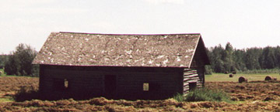
LIVING
The metis in these red river lots: farm houses that were built on the river When the metis weren’t hunting they spent there time gardening and farming. Most metis families lived and farmed along the red and the Assiniboine rivers in Manitoba.
MY COMMENT
The metis lived in farm houses which is pretty cool and basically all of them were by the red river so it would be so cool to just go outside and fish!!!!

Slide 10
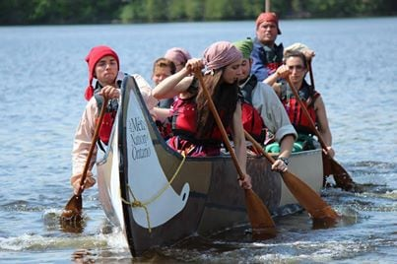
TRANSPORTATION
The metis used the red river cart, York boat and canoes as their main means of transportation. The red river cart had two large wheels and could travel over rough ground. The York boat could hold lots of furs and was used to travel from the forks ( where the red and Assiniboine rivers meet) up to Hudson's bay. The canoe was similar to those of other aboriginal people and made of birch bark.
MY COMMENT
It would be so much fun going to the river in canoes and the York boat looks pretty cool to it would definitely make it a lot easier to do the canoe with a lot of people that means less work.

Slide 11
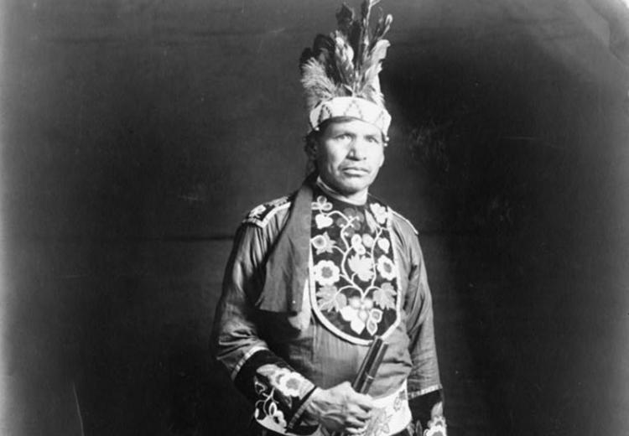
HISTORY
The metis people originated in the 1700’s when French and Scottish and fur traders married aboriginal women such as the Cree, and Anishinabe (Ojibway)…. The metis nation grew up into a distinct culture and became a people in the northwest prior to that territory becoming part of Canada.
MY COMMENT
I find it cool how the French and Scottish both married an aboriginal girl and that how the metis became a tribe.

Slide 12
TRADITIONS
Metis culture has always been festive and celebrated with great joie de vivre. The metis style of dancing to fiddle tunes was very similar to their Celtic and French Canadian antecedents, but seamlessly weaved in faster-paced first nations footwork and rhythms such as in traditional drumming.
MY COMMENT
I love the metis traditions they always look like there having such a great time and I love the way the dress its so unique and awesome.

Slide 13
ART
The metis are heirs to a vibrant culture of decorative arts that emphasizes the brightly colored floral motif in beadwork and embroidery. The Dakota and the Cree, in fact, referred to the metis as the flower beadwork people because of the preponderance of flower designs in their beadwork and embroidery.
MY COMMENT
Wow the metis art is outstanding it is so cool and its crazy how creative the metis can get with there art I wish I could learn how to do that.

Slide 14
CONCLUSION
In conclusion I think that this was a really cool project and I had fun doing it I also learned a lot about metis and there history and backround.

Slide 15
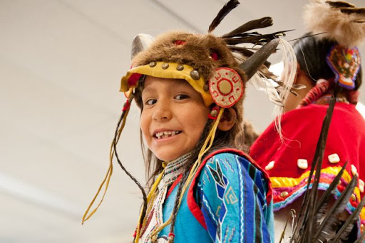
BIBLIOGRAPHY
https://metisarchitecture.files.wordpress.com/20
https://www.bac-lac.gc.ca/eng/discover/aboriginal-heritage/metis/Pages/metis-nation-collection-lac.aspx?wbdisable=true#wb-info
https://prezi.com/dlxqw5x5idzm/metis-food-and-transportation/#:~:text=The%20M%C3%A9tis%20used%20the%20Red,could%20travel%20
https://teaching.usask.ca/indigenoussk/import/metis_culture_and_language.php#:~:text=M%C3%A9tis%20culture%20has%20always%20been,such%20as%20in%20traditional%20drumming.
https://indigenouspeoplesatlasofcanada.ca/article/material-culture/

