Slide 1
Ucluelet First Nations
Culture project
: Amber chalhoub : block g-1 : mr. kraus

Slide 2
Introduction …........................................................................................................................... 3
Languages …........................................................................................................................... 4
Foods …........................................................................................................................... 5
Housing …........................................................................................................................... 6
Clothing …........................................................................................................................... 7
Spiritual beliefs …........................................................................................................................... 8
Music …........................................................................................................................... 9
Transportation …........................................................................................................................... 10
Art …........................................................................................................................... 11
Government …........................................................................................................................... 12
Conclusion …........................................................................................................................... 13
Work Cited …........................................................................................................................... 14 &15
Table of Contents

Slide 3
The Ucluelet first nations are a fascinating and dynamic group that have unique traits and characteristics. They are located off the coast of Vancouver Island in B.C
Culture is: The social behaviour and norms found in human societies. Culture is considered a central concept in anthropology, encompassing a range of phenomena that are transmitted through social learning in human societies (Orgtology)
Clothing, foods, homes, music, traditions/celebrations, groups, language, transportation, art, body piercing/makeup, education, leadership/Government, sports, dances, legends/folklore, weapons/tools, gathering/hunting, jewelry, and religion/beliefs.

Slide 4
Nuu-chah-nulth
(Ucluelet language)
The Ucluelet people speak Nuu-chah-nulth. Their language is considered endangered. As of 2015 there were only 9 fluent speakers, 75 speakers who somewhat understand, and only another 45 learning speakers. Their written language is slightly different to the English language eg. Yuułuʔiłʔatḥ which means Ucluelet.
It's horrible how their language is dying and there will soon be even less fluent speakers.

Slide 5
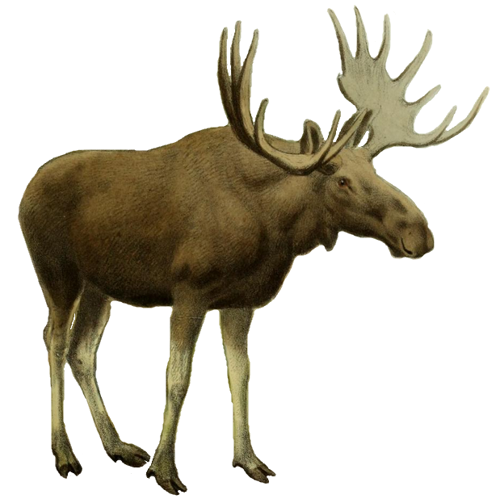
Foods
The Ucluelet people eat mostly seafood, including: salmon, herring, cod, halibut, sardines, whales, seals, sea lions, sea urchins, oysters, mussels, clams, and crab.
Their other foods include: bear, elk, deer, wild plants, and roots.
I love salmon. It's delicious. I would love to try it dried which is how they traditionally prepared their salmon.

Slide 6
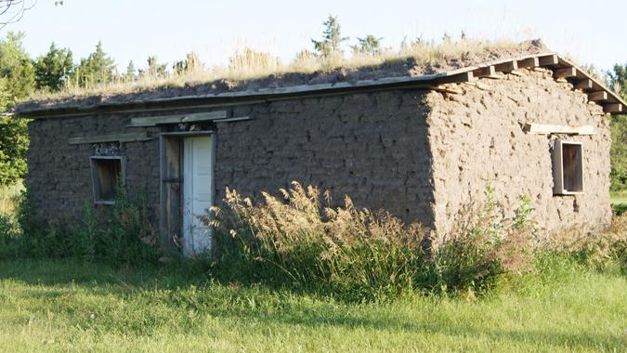
Housing
This is a sod house in which the Ucluelet people traditionally lived. They're made of grass, soil, and wood.
This was great housing for the Ucluelet people at the time because those were the materials available to them.

Slide 7
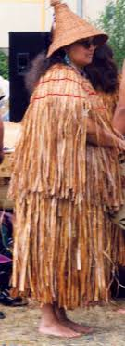
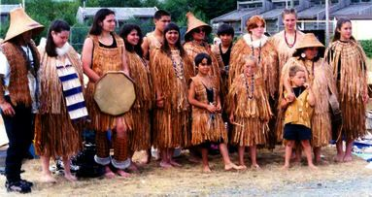
The Ucluelet people had a rich tradition of hats, cloaks, body armour, and masks. They wore minimal clothing due to the warm climate of the pacific coastal area. Much of their everyday clothing was made from cedar fibre.
Clothing
I noticed that the Ucluelet people wore different clothing to some of the indigenous groups further north in colder regions where they wear furs and skins.

Slide 8
Spiritual Beliefs
They belive there is a creator and spirits whose powers bring peace and fortune. Every life form has a spirit and should be respected and appreciated. Shamans ensured the spiritual health of the people. They also restored the balance to their bodies, and even lost souls.
All life forms have a spirit and should be respected and appreciated.
*Fun fact*
The Canadian black bear is their tribe's spirit animal.

Slide 9
Music
Chanting and singing were a big part of the Ucluelet history. They also made instruments from carved wood and animal hides such as drums and rattles
I play piano and sing so music is a big part of my life. I appreciate that they use music to express themselves just like I do.

Slide 10
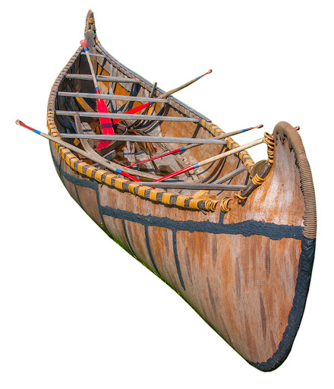
Transportation
The Ucluelet coast people used canoes carved from cedar trees for transportation. These trees are very large with few branches which made it easier for them to shape into canoes.
It's very interesting that cedar trees in B.C can grow up to 80 feet tall! The ucluelet use these trees for so much like the canoes also clothing and instruments.

Slide 11
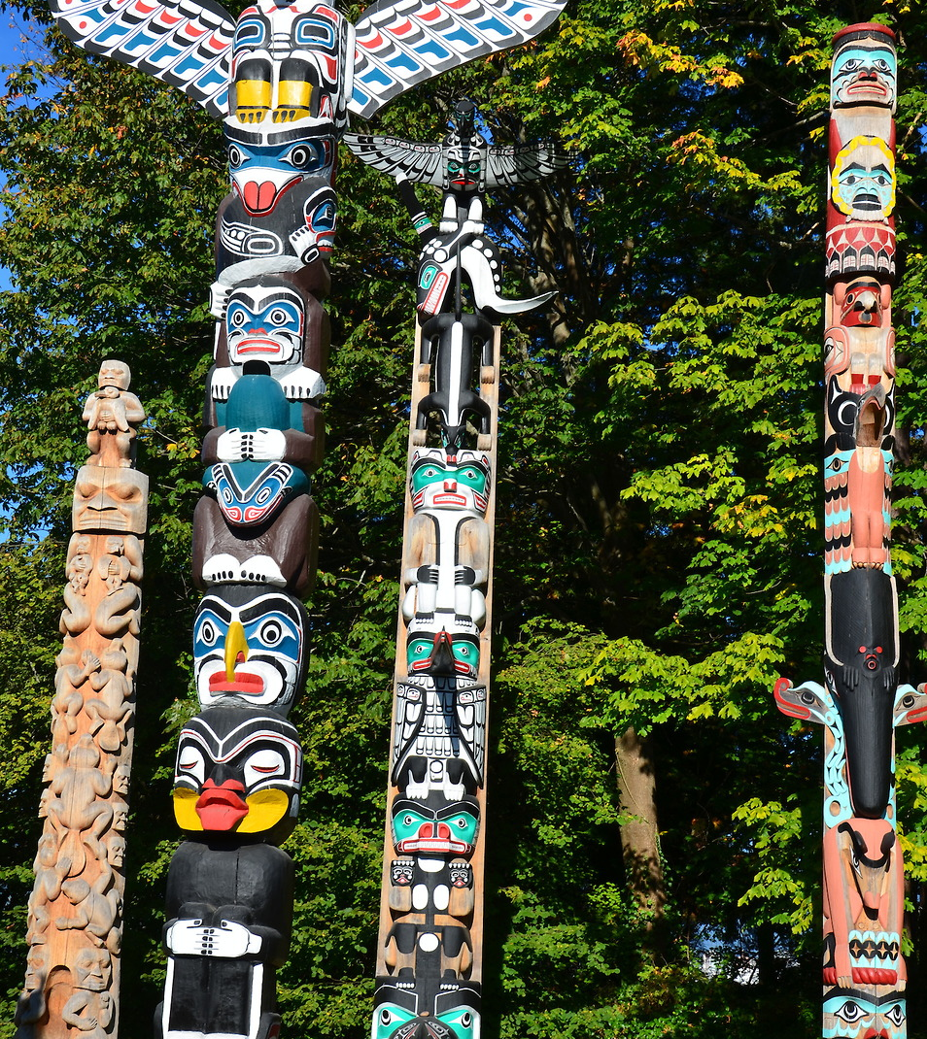
Art
The Ucluelet people had plenty of time at hand to create art. They specifically made totem poles. The purpose of their totem poles was to tell stories, history, and wisdom to pass from generation to generation.
How they wanted to pass down amazing stories and wisdom for generations is insperational. I believe it is so important to keep stories alive and have that history from your ancestors.

Slide 12
Government
The Ucluelet first nations have been self-governed since April 2011. They have certain powers over citizenship and law-making in their territory. They also manage natural resource industries on their territory as well as business and project development, including tourism operations.
It’s great that the Ucluelet people self-govern and have freedom to use resources within their territory.

Slide 13
I have enjoyed learning about the Ucluelet people and have found researching their tribe interesting and informative.
Many indigenous languages are being lost, just like the Ucluelet with only 9 fluent speakers remaining. It's important that we try to keep their languages alive as storytelling is a crucial cultural trait. The Ucluelet people have a wonderful sense of spirituality and tradition. This history is important to remember and teach to future generations. Finally, the totem poles carry all the Ucluelet history and stories. Looking at these beautiful pieces of art helps us remember the hardships and joy of the Ucluelet people.
All indigenous groups should be respected and appreciated for their history in Canada and the contributions they have made to this country.

Slide 14
Flag image pg.1 http://www.ufn.ca/
Salmon image pg. 2, 14,& 15 https://shop.slcc.ca/learn/the-salmon/
Introduction background pg.3 https://qmackie.com/2010/03/11/ucluelet-1859/
Language background pg.4
https://www.tripadvisor.ca/LocationPhotoDirectLink-g154942-d254778-i306540194-Long_Beach_Lodge_
Resort-Tofino_Clayoquot_Sound_Alberni_Clayoquot_Regional.html
Research (language) pg.4 https://www.thecanadianencyclopedia.ca/en/article/ucluelet-first-nation
Elk image pg.5 https://commons.wikimedia.org/wiki/File:The_deer_of_all_lands_(1898)_Elk_white_background.png
Pacific salmon pg.5 https://www.nps.gov/glba/learn/nature/coho-salmon.htm
Research (foods) pg.5 https://en.wikipedia.org/wiki/Ucluelet_First_Nation#:~:text=The%20food%20resources%20spread%20across,elk%2C%20wild%20plants%20and%20roots
Sod house background pg.6
https://lexch.com/news/local/the-sod-house-relic-of-the-past/article_c0bfc73b-257a-5bdf-8867-8f752ca0e3bf.html
Research (housing) pg.6 https://www.thecanadianencyclopedia.ca/en/article/sod-houses
Cedar bark clothing images pg.7 http://www.cathedralgrove.eu/text/03-Europeans-Care-1.htm
Research (clothing) pg.7
https://donsmaps.com/pacificnwclothingmasks.html#:~:text=The%20First%20Nations%20people%20of,made%20of%20shredded%20cedar%20fibre.
Work cited
Black bear background pg.8
https://abcnews.go.com/US/black-bear-attacks-humans-rare-begin-scuffles-dogs/story?id=65413852
Research (spiritual beliefs)pg.8
https://www.thecanadianencyclopedia.ca/en/article/ucluelet-first-nation#:~:text=Languages%20in%20Canada.)-,Religion%20and%20Spirituality,therefore%20be%20respected
%20and%20appreciated.
Man with drum background pg.9 https://www.westerlynews.ca/news/indigenous-tourism-blossoming-on-vancouver-island/
Research (music) pg.9 https://en.wikipedia.org/wiki/Indigenous_music_of_Canada
Canoe image pg.10 http://www.anishinabenation.ca/en/birch-bark-canoe-canot-decorce1-2/
Research (transportation) pg.10
http://firstpeoplesofcanada.com/fp_groups/fp_nwc4.html#:~:text=The%20canoes%20of%20the%20
Northwest,long%20and%208%20feet%20wide.
Totem pole image pg.11 https://www.encirclephotos.com/image/totem-poles-in-stanley-park-in-vancouver-canada/
Research (art) pg.11 https://en.wikipedia.org/wiki/Indigenous_peoples_of_the_Pacific_Northwest_Coast
Ucluelet background pg.12 https://www.nwseaplanes.com/charter-flights/seattle-to-ucluelet-flights/
Research (government) pg.12
https://www.thecanadianencyclopedia.ca/en/article/ucluelet-first-nation#:~:text=Languages%20in%20Canada.)-
,Religion%20and%20Spirituality,therefore%20be%20respected%20and%20appreciated.

