Slide 1
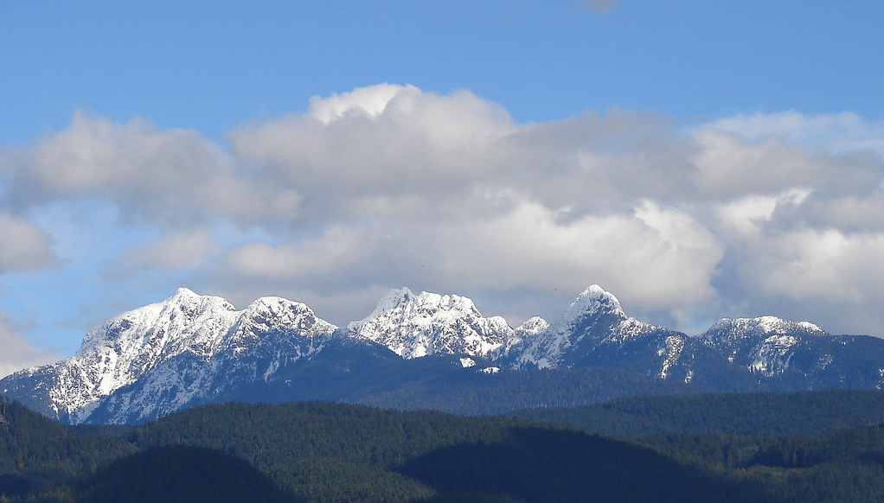
CREATING CHANGE LEADERSHIP
2021/22 Credited Class

Slide 2
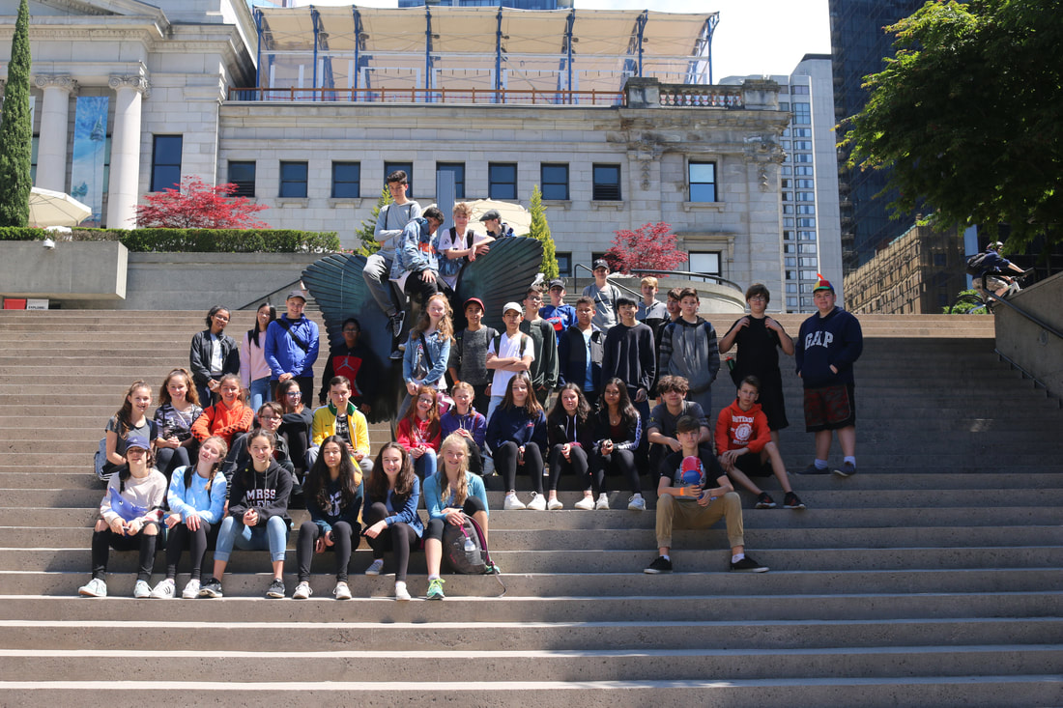
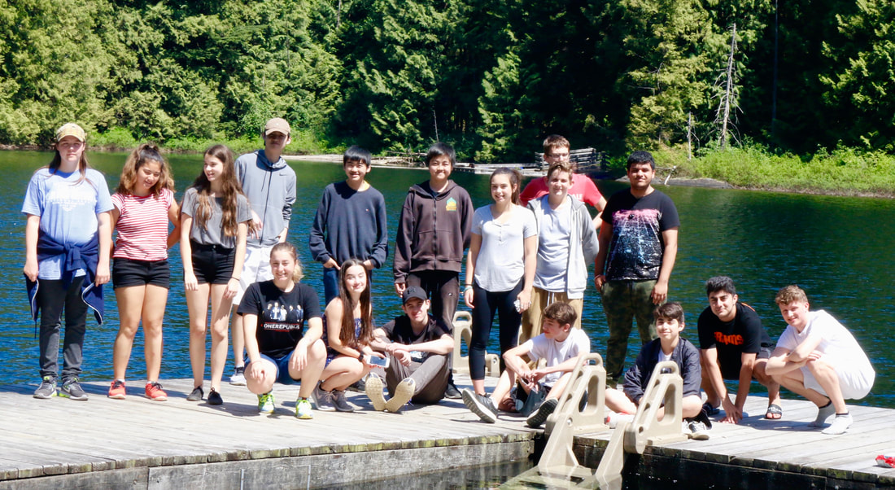
What is Creating Change/Leadership?
This year, it is a club in which we learn how to create positive and meaningful changes in ourselves, our school and our community. In developing leadership skills, we can effectively work together to impact others for the better. In 2021/22, this course will be for anyone who would like to improve themselves, their surroundings, and is willing to take the leap to do so. If numbers are strong, it will be offered in the timetable (Focus: Personal Development) as well as outside the timetable (Focus: School and Community ).

Slide 3
Why is Creating Change/Leadership Important?
It’s evident that positive change is needed, especially due to what has happened over the last year: COVID-19, Black Lives Matter, Indigenous Recognition, and the crazy political instability. We seen how broken we are as humans and how vulnerable we can be. We’re not perfect and far from it. We often hear the statement, “Change the world.” But what we might not realize is that change starts small; in ourselves, our homes and community. It’s the small things we do that add up. We can’t stand by and expect things to change on their own. Fortunately, we don’t need to be on top to fix the foundation. If you want to make changes for the better than this course is for you: build confidence, take a stand, and make a difference!

Slide 4
“How can one lead if they refuse to ever be led?” - L Kraus
Lead•er•ship /'li:dəʃɪp/ n [U] •Leadership refers to the set of characteristics that make a good leader: Strong and effective leadership might have made the team more successful.
Exert taken from Cambridge International Dictionary of English © 1955

Slide 5
“Making a meaningful and positive change in the school and community.”
Creating change has done many different things around the school such as:
Class/Grade/Group breakfasts
Leadership training and development
Staff functions/events
Events like Tic Tok competition
Student voice
Mental Health Support
Promote and support all areas of school: athletics, music, theater, clubs…

Slide 6
"A good leader inspires people to have confidence in the leader, a great leader inspires people to have confidence in themselves."
~ Eleanor Roosevelt
"I alone cannot change the world, but I can cast a stone across the waters to create many ripples."
~ Mother Teresa

Slide 7
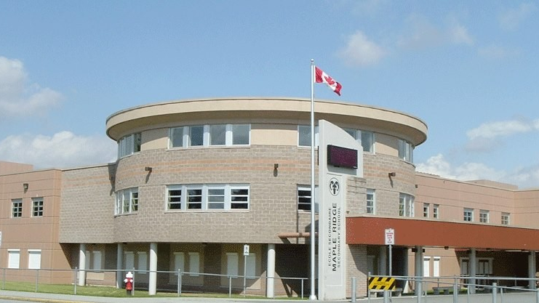
Thank you and don’t forget to, “Take a chance to make a change that is meaningful to you and others.”

